Slide 1
DBM2: NYC SQUIRRELS
Hongjie Zheng
Luca Nardone

Slide 2
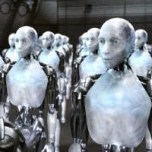




Dataset and Preprocessing
🐿️ NYC Squirrel Census dataset→ 3,023 sightings with 36 attributes
Removing duplicates
This ensures that each row in the dataset corresponds to a unique squirrel
Checking for missing values
Identify any missing values in the dataset, which might need to be handled before proceeding
Dropping irrelevant columns
Dropping irrelevant columns, with too much missing data, that won't contribute to the analysis
Handling missing data
By replacing some of them with the string Unknown and discarding rows with missing values in critical columns

Slide 3
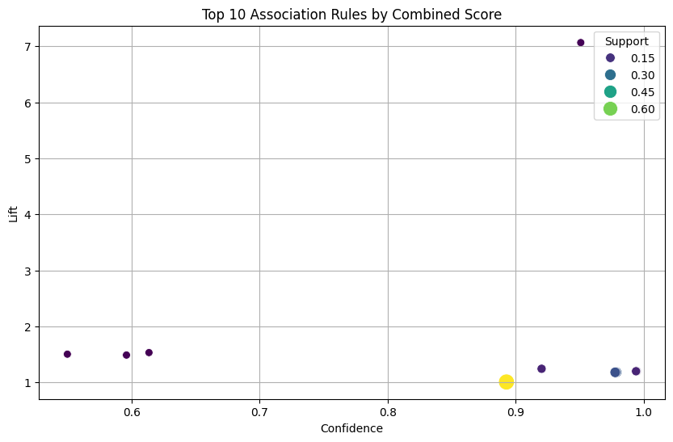
Frequent Pattern Mining
Identify frequent patterns and associations between fur color and behaviors.
ONE-HOT encoding to converts data into binary format
Apriori algorithm to find frequent itemsets with minimum support of 5%
Generate association rules based on the frequent itemsets and filter them to retain only the strongest rules
Create a scatter plot to visualize the top 10 association rules

Slide 4
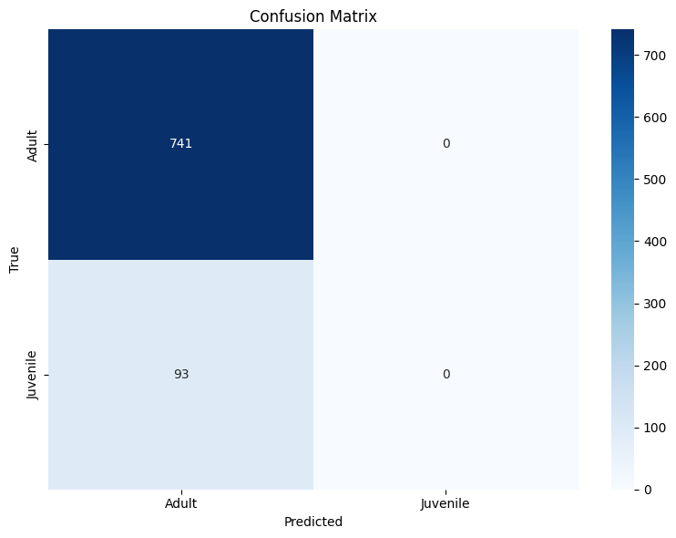
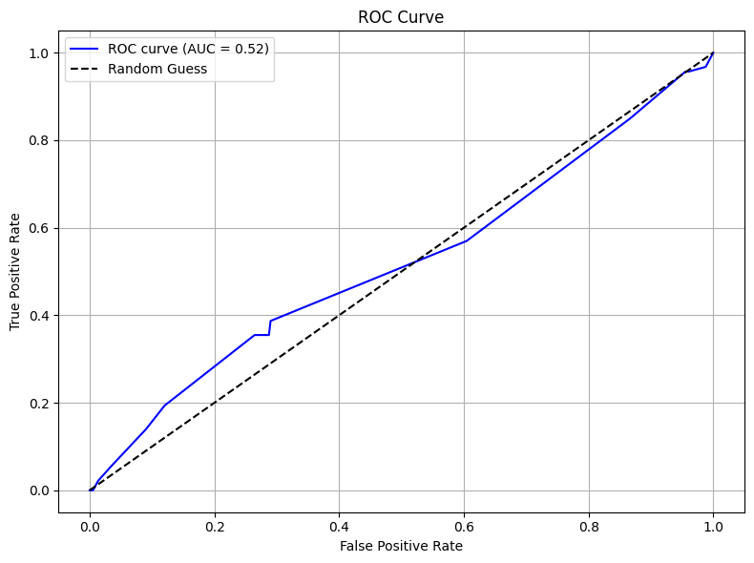
Classification
Classify squirrels into different age groups based on their fur color
Label Encoding: Converted categorical variables into numeric values to prepare for classification
Boolean Encoding: Converted True/False values into binary (0/1)
Train-Test Split: The dataset was split into training and testing sets, with 30% of the data used for testing and 70% for training
Decision Tree Classifier: A Decision Tree Classifier was used with the entropy criterion to classify the squirrels into age categories
Class Imbalance problem: The age categories were highly imbalanced, with a larger proportion of adult squirrels in the dataset.

Slide 5
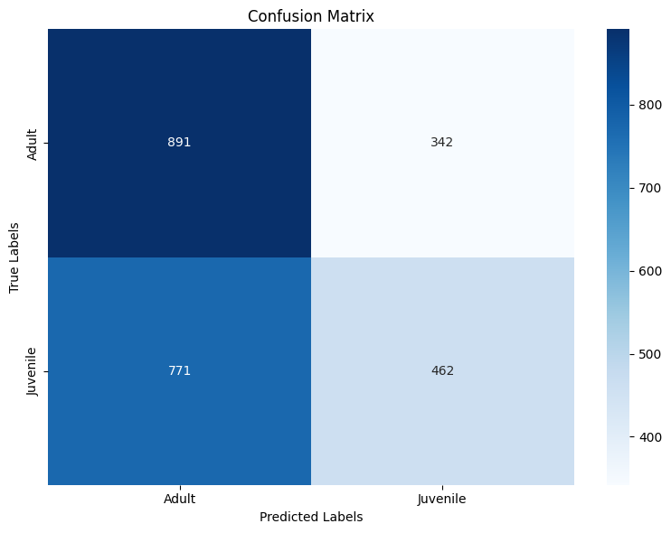
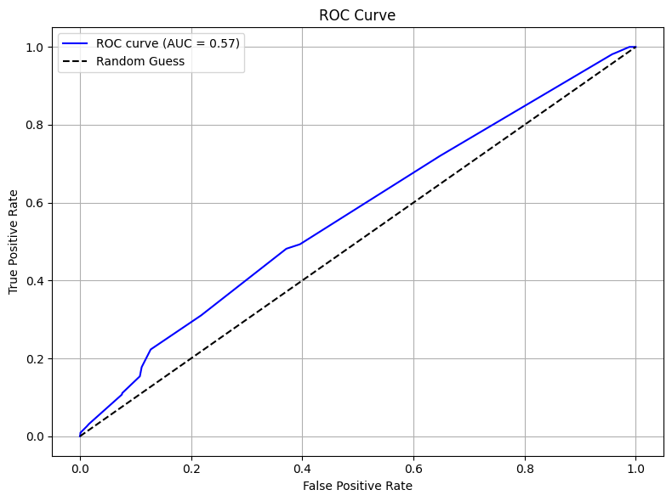
Classification improvements
Balancing the dataset:
Applied Random OverSampling method to duplicate samples from the minority class until the classes are balanced.
The model would learn better from both the minority and majority classes:
Try to improving Model Results:
Random Forest Classifier was used to replace the Decision Tree model
It is more robust with his ensemble of trees
This model addressed the imbalance better by aggregating multiple decision trees, each considering different subsets of data:

Slide 6
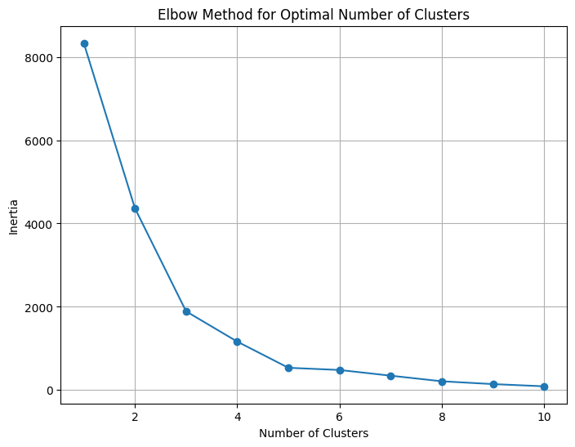
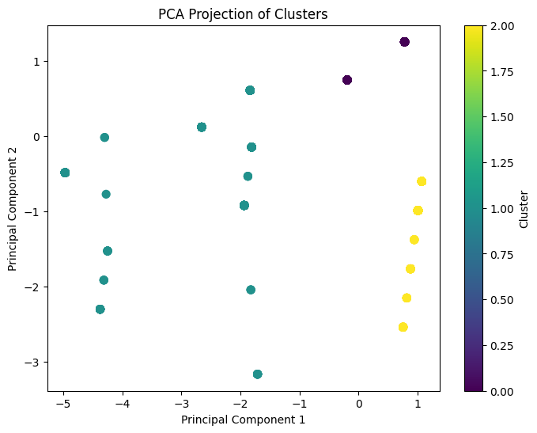
Clustering
Identify natural groupings of squirrels based on fur colors:
K-Means Clustering
Chose 3 clusters as optimal using the Elbow Method
Applied the K-Means algorithm to identify groups in the data
PCA for Visualization
Used Principal Component Analysis (PCA) to reduce data dimensions to 2 for easier visualization
The Silhouette Score of 0.71 → clusters are well-defined but it could be improved

Slide 7
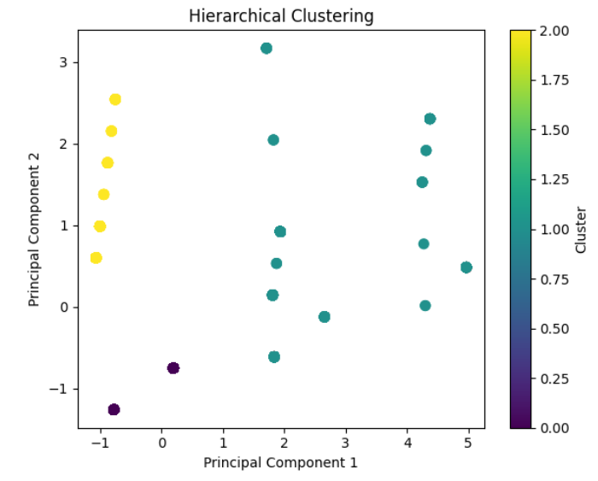
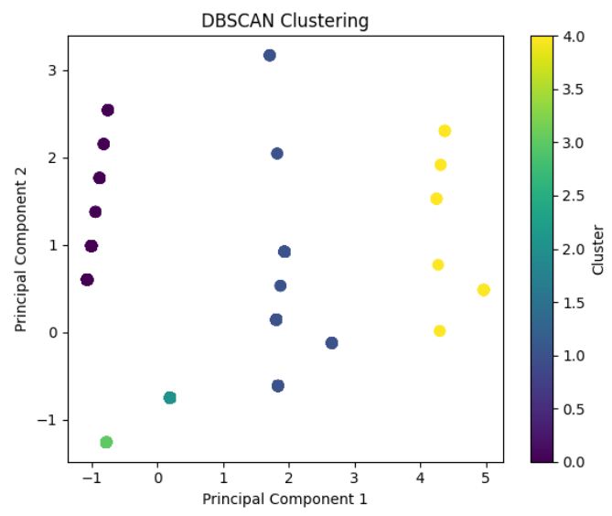
Clustering improvements
Hierarchical Clustering
With 3 clusters again
DBSCAN
With eps=1.5 and min_samples=2
Silhouette Score of 0.71
Silhouette Score of 0.88

Slide 8
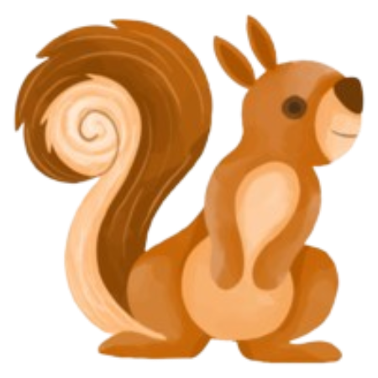
Thanks for your attention
For Question:
luca.nardone@insa-lyon.fr
hongjie.zheng@insa-lyon.fr

